Slide 1
Hybrid optimization for valid cable rings
Exact feasibility and hub count, followed by anytime cable-cost improvement
Team: ResPlan Co-Design Members: Jahnavi Akveti & team
Solver pipeline
Assumptions and choices
• Devices are generated inside eligible rooms with 0.5 m wall and window clearance.
• Rooms below 2 m² are ignored. Each hub serves ≤5 devices and ≤100 m².
• Every route is axis aligned, passes through doors and returns to the same panel.
• Excluded areas remain blocked unless strict routing proves no valid alternative.
• The 17k-plan ResPlan dataset supports lookup, tuning and held-out evaluation. No model training is required.
Plan ID
ResPlan geometry
Door graph
Valid room adjacency
Connected zones
Capacity-feasible sets
Ring pool
K routes + exact order
Global CP-SAT
Minimum H, then J
ALNS
Repair + annealing
Independent checker
JSON + overlay + proof
Lexicographic objective: min H then J = L + 5X + O + 0.5B then ΔA gap
Exact within the generated candidate pool; ALNS keeps the best valid incumbent as time allows.
Intermediate update • 16 October 2026
Intermediate update | Team: ResPlan Co-Design | 1 / 3
Notes:
The solver separates hard feasibility from cable-cost optimization.
CP-SAT proves the minimum hub count over connected feasible zones.
Held-Karp solves the visit order for up to five devices, while direction-state A* supplies legal rectilinear paths.
A ring candidate contains the zone, positions, order and complete geometry. Global CP-SAT accounts for interactions between rings.
ALNS then perturbs rooms, positions and paths, while preserving the best checked solution.

Slide 2
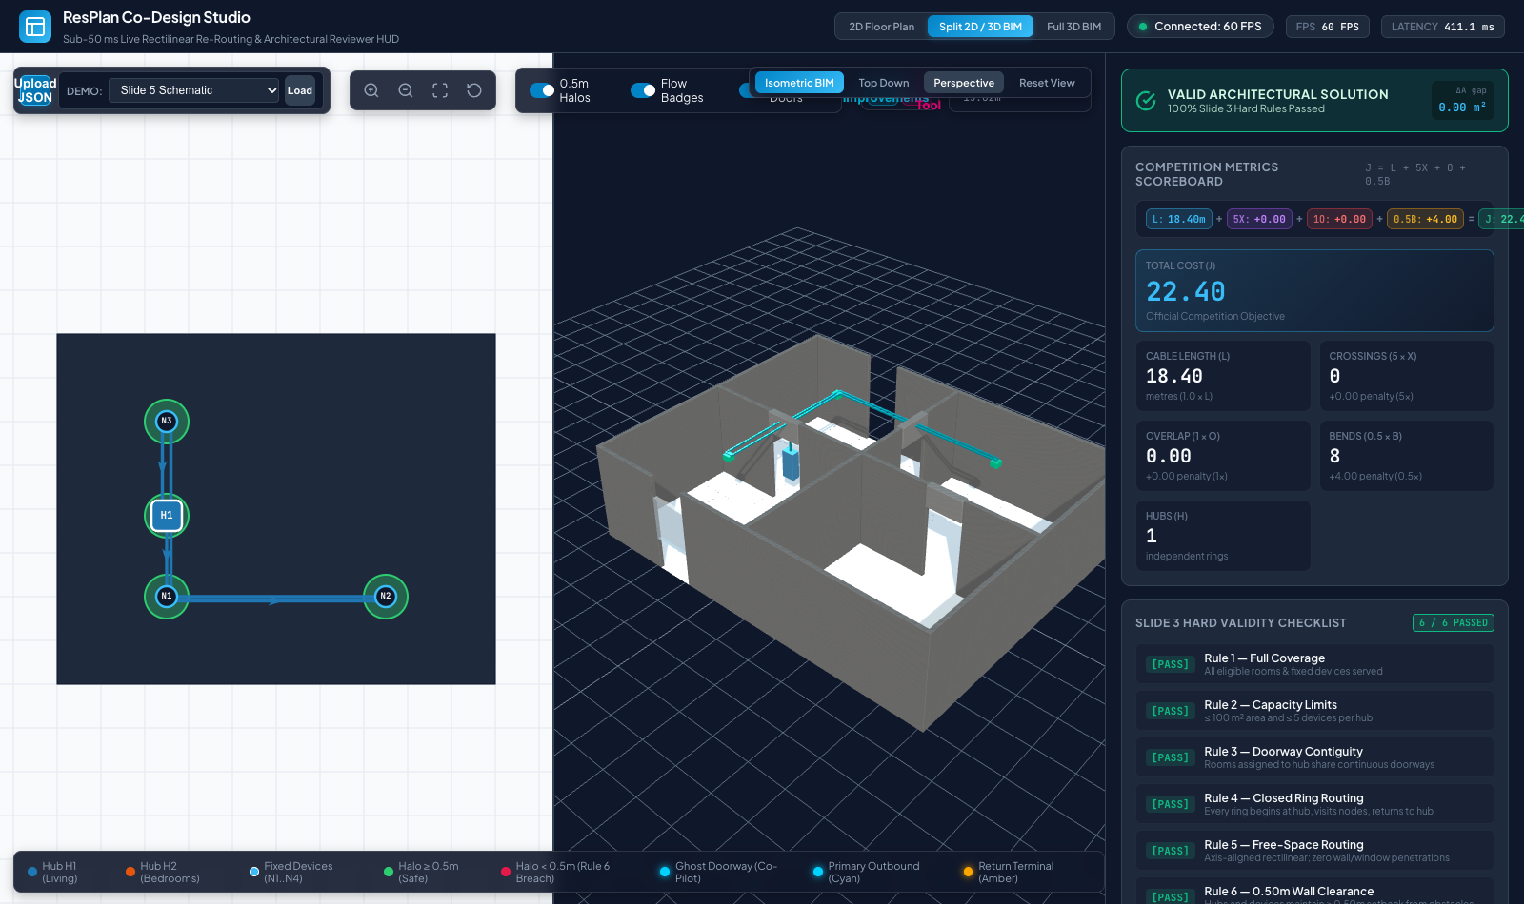
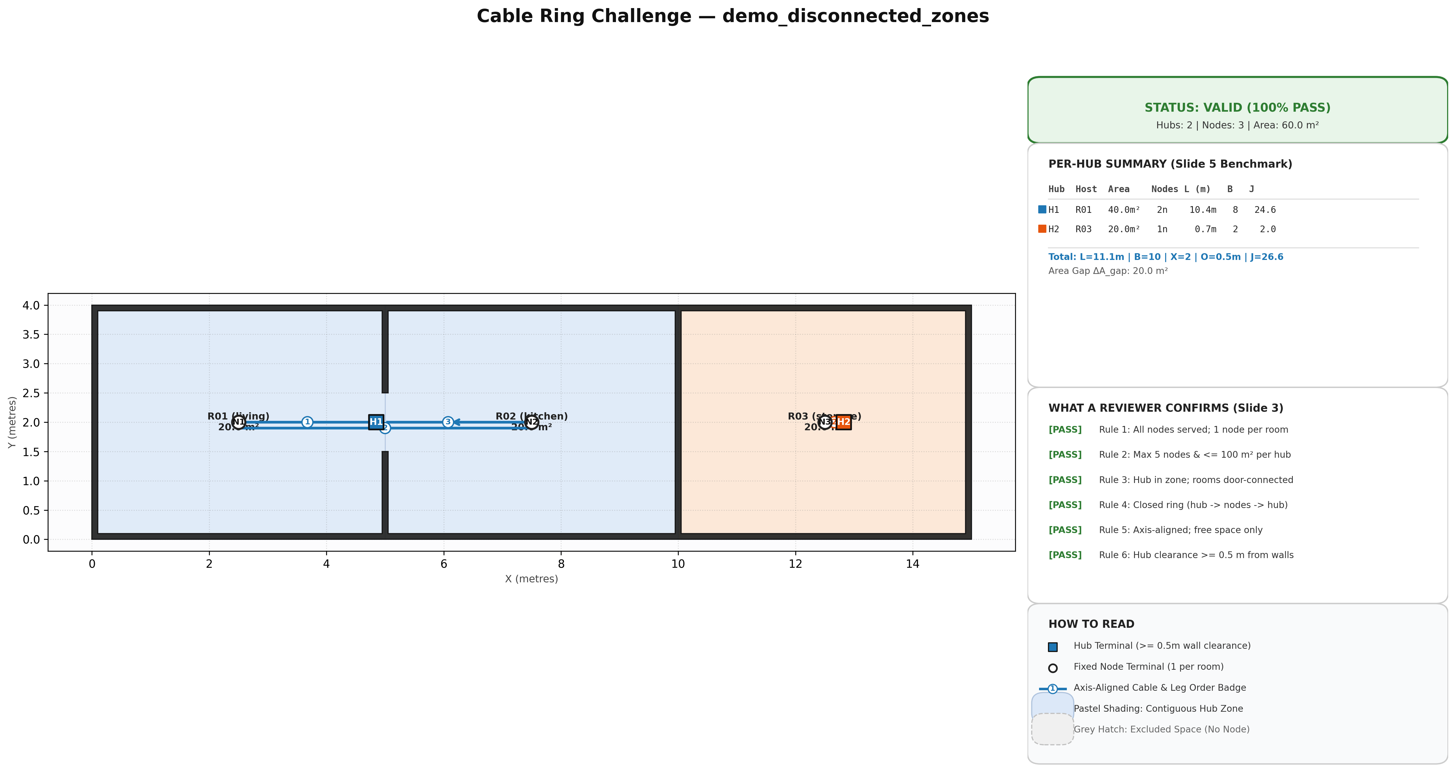
Current progress and measured evidence
The foundation is valid; a disconnected case exposes the remaining optimization gap
Verified today
136 automated tests pass
• End-to-end JSON, PNG and interactive 2D/3D output
• Door topology, direction-aware A* and geometric checker
• Exact Held-Karp order for each ≤5-device ring
• Minimum hub count certified on the demo fixtures
Measured limitation
The sequential router returns J=26.57 on the disconnected case. An independently checked route with the same H=2 reaches J=15.975, a 40% reduction.
Next algorithmic step
Multiple complete ring candidates, global CP-SAT selection and ALNS refinement.
H 1 L 18.40 m B 8 X 0 O 0
J 22.40 6 of 6 hard rules pass
Current: H 2, J 26.57
Checked alternative: H 2, J 15.975
Best current valid demo
Hard case: same hubs, avoidable cable cost
Intermediate update • 16 October 2026
Intermediate update | Team: ResPlan Co-Design | 2 / 3
Notes:
The left image is the current studio and checker output, with all six hard rules passing.
Across the current repository, 136 automated tests pass.
The right image is the key optimization counterexample. The current route is valid but costs 26.57.
A second independently checked route uses the same two hubs and costs 15.975, so the next solver must optimize interactions globally.

Slide 3
Remaining work and differentiation
The next build closes the measured cost gap and connects the 17k-plan dataset to the studio
Remaining issues current scope
Differentiation after the exact core
1. Dataset Plan ID workflow
Index ResPlan.pkl once, adapt Shapely geometry and return a cached 2D/3D preview.
2. Joint cable optimization
Generate several legal paths and complete rings, then select them globally with CP-SAT.
3. Bounded search time
Cache grids and routes; ALNS always returns the best checked incumbent at the deadline.
4. Evidence at dataset scale
Compare hybrid J and runtime against the required greedy baseline on held-out plans.
Anytime proof dashboard: show greedy cost, best cost, lower bound and gap while search runs.
Explainable alternatives: compare routes and expose the length, bend, crossing and overlap trade-offs.
Resilience simulation: cut any cable segment and demonstrate closed-loop service behaviour.
Learned warm-start: rank promising candidates later; validation and CP-SAT remain authoritative.
Next steps and help needed
Index and preview Plan IDs • generate legal device candidates • build K-route and ring pools • add global CP-SAT + ALNS • benchmark against greedy
Help requested: confirmation of the final organiser input schema and checker interface.
Intermediate update • 16 October 2026
Intermediate update | Team: ResPlan Co-Design | 3 / 3
Notes:
The critical path starts with Plan ID lookup because all official cases come from ResPlan.pkl.
The global candidate selector closes the concrete gap observed on the disconnected case.
ALNS adds improvement under a time limit without sacrificing a valid incumbent.
The dataset supports benchmarking and parameter tuning. We do not need to train a model for the core submission.

